Slide 1


Bank Loan of Customers|Finance
Team Members Siddhant Divekar Mahesh Shinde Jatin Bargaiya Suraj Bhadoriya Sarthak Narnor
P193

Slide 2
Project Objective
This is Bank Loan of Customers Project Where Provided 2 dataset to us With csv extension files having 39k rows each and the objective was to analyze the growth that bank got within given years in loans.
We used MS-Excel ,MySQL for analyzing ,cleaning and removing duplicates from dataset and prepared KPI’s .Where we did calculations ,merging and Prepared interactive Dashboards

Slide 3
We perform this project in 4 modules :-
Excel
Tableau
Power Bi
SQL

Slide 4
KPI’s
Year wise loan amount Stats
Grade and sub grade wise revol_bal
Total Payment for Verified Status Vs Total Payment for Non Verified Status
State wise and month wise loan status
Home ownership Vs last payment date stats

Slide 5
KPI’s 1:Year wise loan amount Stats
By Observing we can see how loan amount status is increasing year by year
Year 2007 having 22,19,275 loan amount to Year 2011 with 260,506,575 loan amount
We can subtract the new value from old to see the difference
260506575-2219275= 258287300
Loan amount status is increases by 258287300 in 4 year of duration
Year | Loan Amount
2007 | 2219275.00
2008 | 14390275.00
2009 | 46436325.00
2010 | 122050200.00
2011 | 260506575.00
Grand Total | 445602650.00

Slide 6
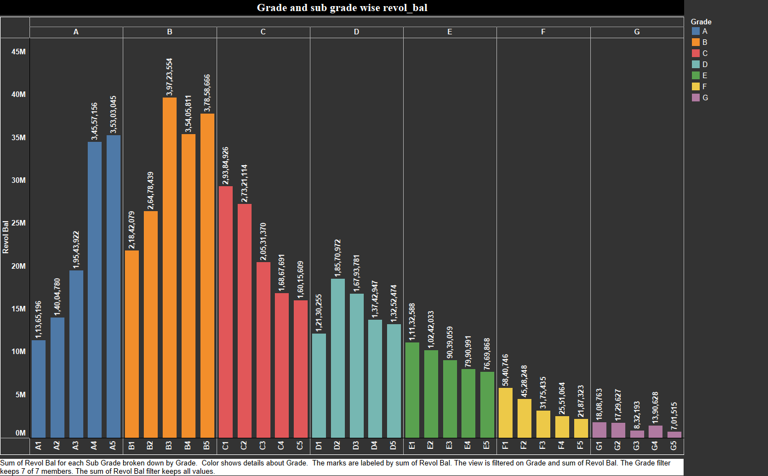
KPI’s 2: Grade and sub grade wise revol_bal
In this Grade and subgrade wise Revol
balance we can notice Grade-B have
more revol balance then any other grade
& Grade – G have very low revol balance.
More number of customers took loan in
Grade B .
Similary, it goes for other grades also
B>A>C>D>E>F>G order for revol bal as per
annual income

Slide 7
KPI’s 3: Total Payment for Verified Status Vs Total Payment for Non Verified Status
Looking at pie chart we can observe that verified status have 58.88% of total payment and 41.12% of total payment which are Not Verified for the Loan Amount
The bank needs a loan application to initiate the document collection and verification process
Verification Status
Verified
21,98,92,307.510836
Not Verified 15,35,41,418.210599

Slide 8
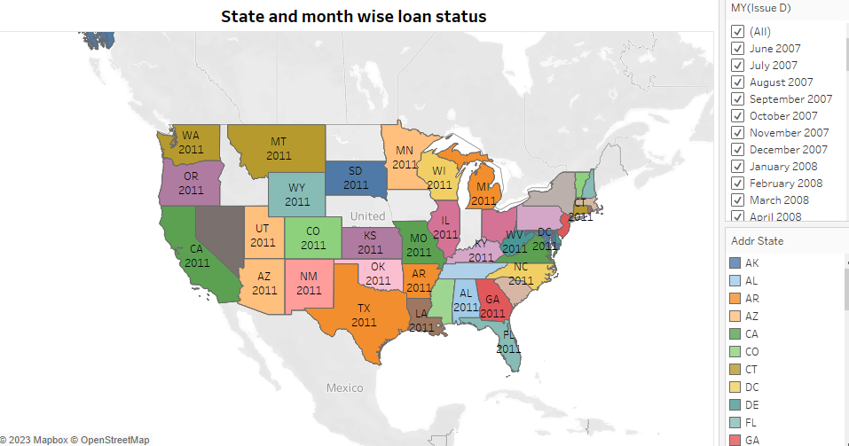
KPI’s 4: State wise and month wise loan status
The Left graph shows the count of Loan Status in each state of USA on particular last credit pull date.
As we can see CA has given maximum customers who took Loan i.e >5000 is the count of loan status
Here , it is clearly seen that in top 10 states, CA has given highest amount of loan to customers and lowest is MA. But, maximum of customers in each state has fully paid status followed by Charged off and current.

Slide 9
KPI’s 5: Home ownership Vs last payment date stats
The right graph shows the Home ownership and the amount paid for each on last payment date.
Here, we can see that maximum latest amount paid by customers with MORTGAGE home ownership is 56305545.81.
It concludes that many of the customers are about to repay their loan amount for their particular home ownership.
Home Ownership | Last payment amount
MORTGAGE | 56305545.81
NONE | 533.15
OTHER | 173239.20
OWN | 8228967.44
RENT | 41686653.09
Grand Total | 106394938.69

Slide 10
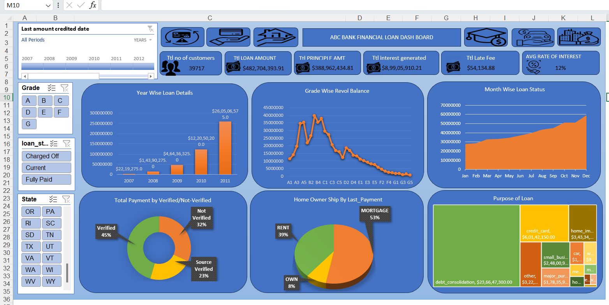
Dashboard of Excel

Slide 11
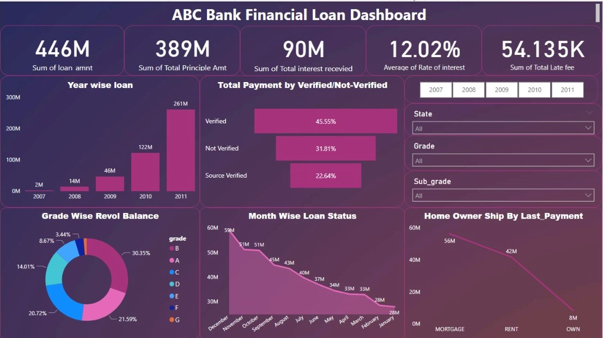
Dashboard Of Power BI

Slide 12
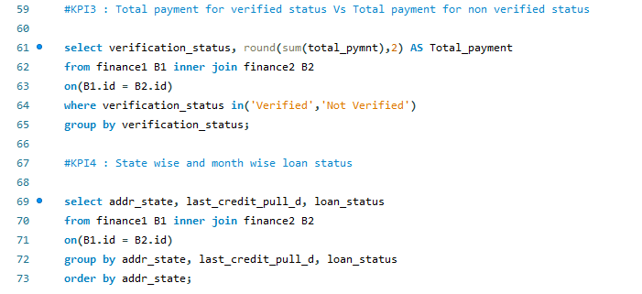
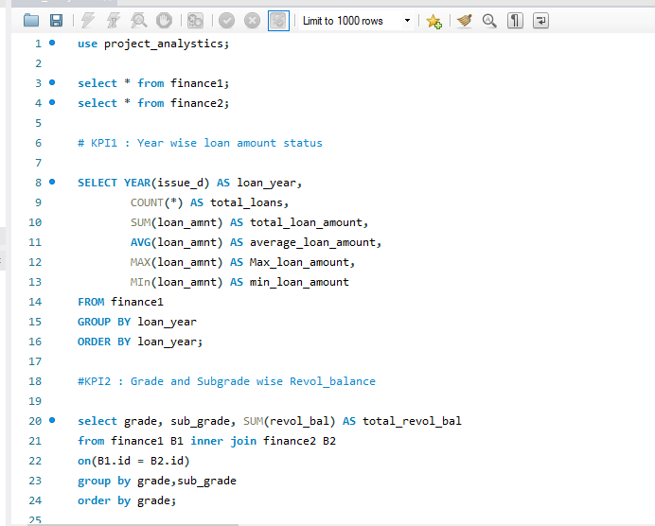
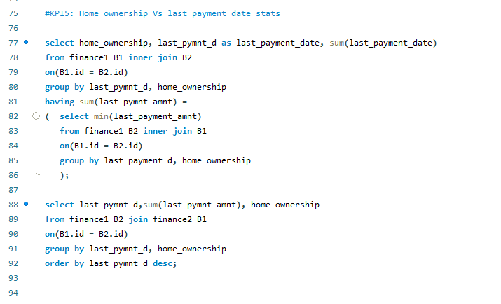
SQL

Slide 13
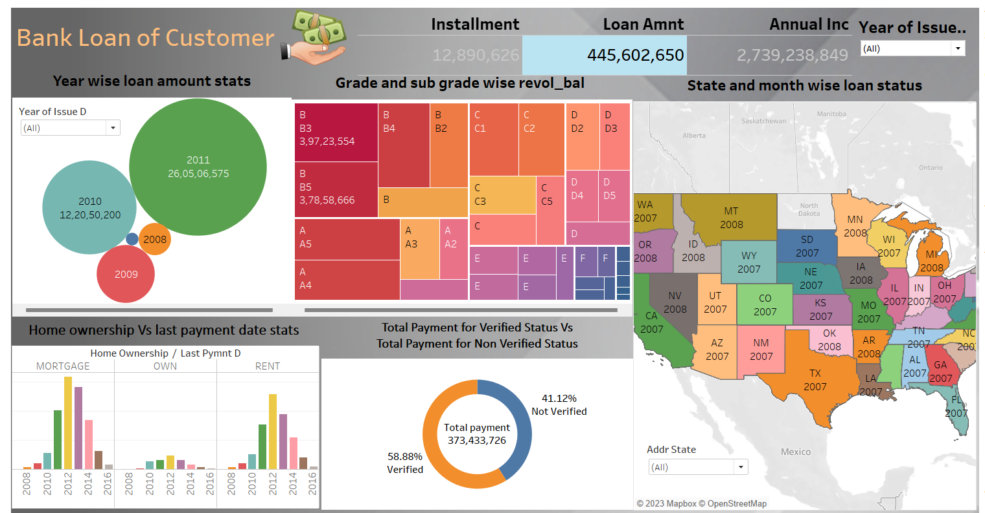
Dashboard of Power BI

Slide 14
Challenge Faced

Slide 15
Thank You 🙏

